Slide 1
Effectiveness of Female Community Health Volunteers Training Program on Hypertension Knowledge and Blood Pressure Measurement Skills in Kavrepalanchowk, Nepal
Prasansha Poudel¹, Bihungum Bista¹, Sushmita Mali ², Archana Shrestha^{1, 2, 3}
Prasansha Poudel¹, Bihungum Bista¹, Sushmita Mali ², Archana Shrestha^{1, 2, 3}
¹Department of Public Health, Kathmandu University School of Medical Sciences, Dhulikhel, Nepal
²Institute for Implementation Science and Health, Kathmandu, Nepal
³Department of Chronic Disease Epidemiology, Yale School of Public Health, New Haven, USA

Slide 2

Outline
Background
Objectives
Methodology
Results
Conclusion and Recommendation
References
Notes:
I will start with background,objectives, methodology,then present our results and conclusion and recommendation.

Slide 3
Background
Health impact
Burden
54% of strokes and 47% of coronary heart disease cases globally.¹
In 2019, hypertension prevalence in Nepal :25% ,male (30%) and female (20%).³
In 2020, hypertension prevalence in LMICs is 31.5%,compared to 28.5%, in high income.²
Notes:
Starting with the background in health impact of HTN, globally there are 54% of strokes and 47% of coronary heart disease
In burden of HTN, in 2020…….

Slide 4
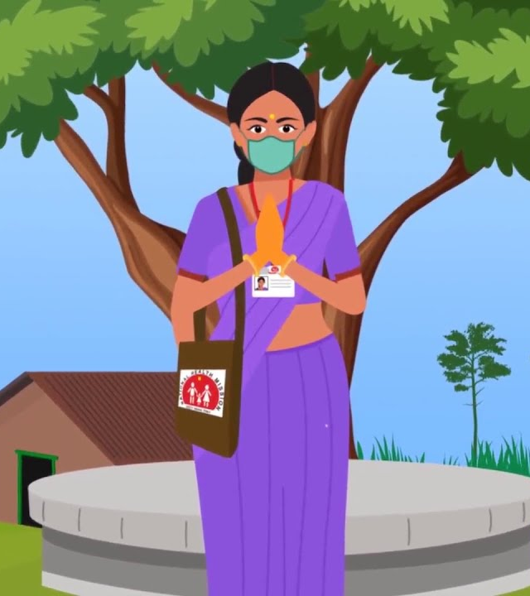
Female Community Health Volunteers (FCHV) program in Nepal:
Established in 1988.⁴
Total 51,423 FCHVs. ⁵
FCHVs have a crucial role in preventing, managing, and treating hypertension.⁶
Notes:
They are frontline in Nepal and they play a role in the prevention, management and treatment of HTN in the future.

Slide 5
Community health worker and hypertension
87% of CHW grasp the idea that hypertension can develop without risk factors.⁷
8 studies suggest that CHW can be trained in CVDs prevention and management.⁸
Regular high-quality supervision is crucial for maintaining CHW performance.⁹
Notes:
Study from south Africa shows that 87% of CHW grasp the idea that hypertension can develop without risk factors.
A Systematic review in low and middle income countries shows that results of 8 studies, indicates that CHW can be effectively trained in CVD prevention.
Similarly,Study from Kenya shows that regular supervision is one of the most important intervention in maintaing CHW performance.

Slide 6
FCHV and Hypertension in Nepal
•99% of FCHVs expressed to participate in community-based hypertension education and screening programs without incentives.¹⁰
•FCHVs home-based lifestyle intervention with regular monitoring to reduce blood pressure. ¹¹
Notes:
Studies from Nepal shows that, 99% of FCHVs wiiling to participate in community-based hypertension without incentives.
In western Nepal, FCHVs were effective in leading the home based lifestyle intervention with regular monitoring.

Slide 7
FCHVs Led Hypertension Prevention and Control in Nepal
Project in collaboration with Kathmandu University School of Medical Sciences, World Health Organization, and the Institute for Implementation Science and Health.
Aim to assess the reach, effectiveness, adoption, implementation and maintenance of the FCHV-led hypertension.
In Namo buddha municipality to inform the government about the scale-up potential.
Notes:
Despite this early success, a large scale up of FCHV led HTN management program has been limited. So the project……… so our study is one of the part of this larger study.

Slide 8
Objectives
General objective:
To assess the effectiveness of one day training for female community health volunteers on hypertension knowledge and blood pressure measurement skills in two municipalities of Kavrepalanchowk district.

Slide 9
Specific objectives:
To assess the effect of a one-day training of FCHV on their hypertension knowledge level
To assess the effect of a one-day training of FCHV on their skills to measure blood pressure.
To assess the association of FCHV’s socio-demographic characteristics with their end-line hypertension knowledge and BP measurement skills.
To determine the association of FCHV’s general performance with their end-line hypertension knowledge and BP measurement skills.

Slide 10
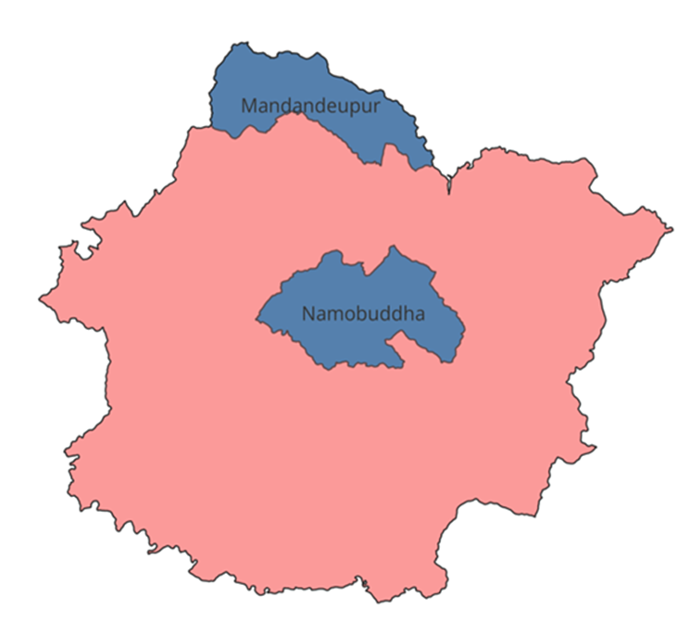
Methodology
Study design: Quasi-experimental study
Study site
Two municipalities of Kavre district ( Namobuddha and Mandandeupur).
Justification
The university already had a base and working there and it was feasible
Semi urban municipalities of Kavre district shows that the 22.1% of people have hypertension.¹²

Slide 11
Study population: FCHVs
Inclusion criteria
Appointed as FCHV
Age 18 years and older
Exclusion criteria
Not able to respond
Out of municipality

Slide 12
Sample size
Mean difference = 1.45 ¹³
Standard deviation = 4.18 ¹³
The sample size was 136.
Sample size was calculated by comparing paired differences.¹⁴
Sampling technique
Convenient sampling
All FCHVs of those selected municipalities

Slide 13
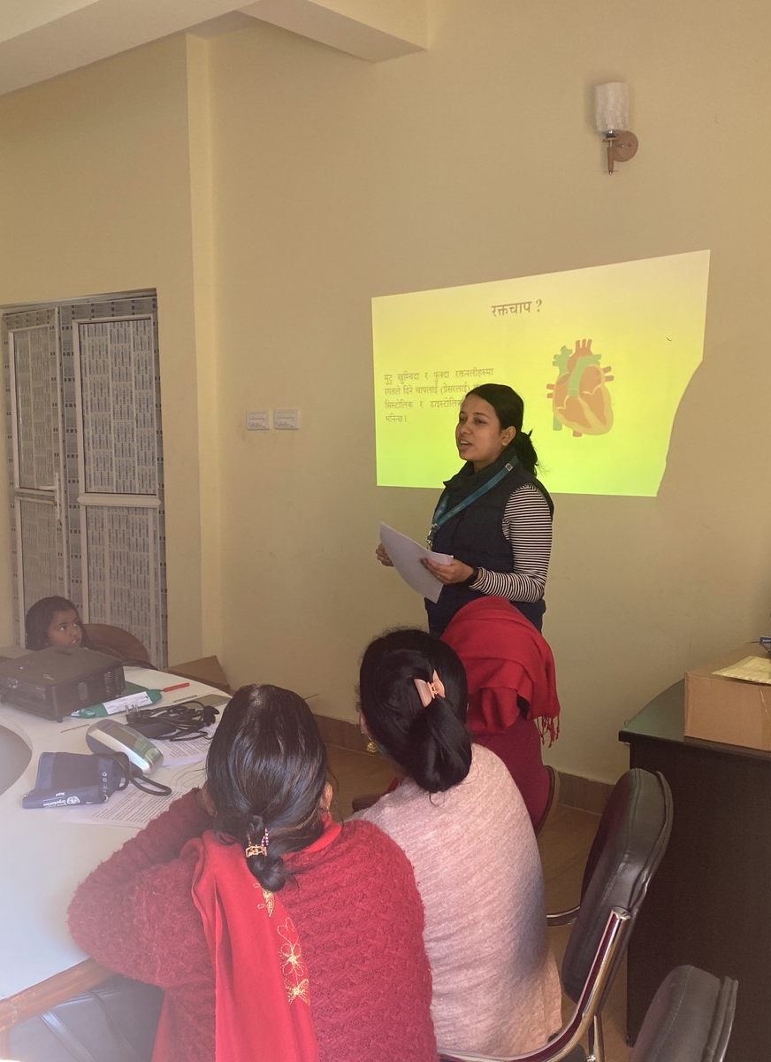
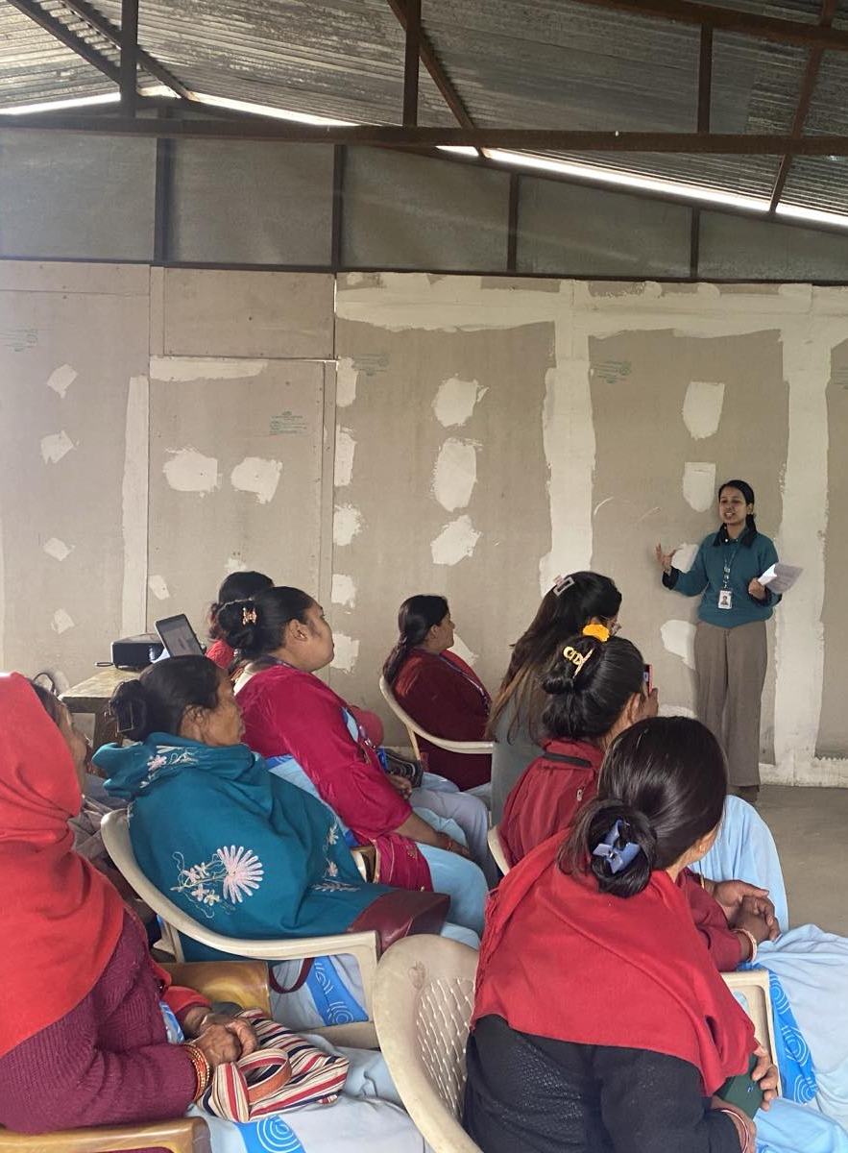
Training Details:
1) Hypertension Knowledge
  Classification of blood pressure
  Causes and symptoms of hypertension
  Risk factors and complications of hypertension
  Benefits of lifestyle changes
  Potential barriers to hypertension management
  Prevention and control of hypertension
Notes:
We conducted one day training for FCHVs, our training was guided by health belief model. This was a two our session, our slides were basically a mix of pictures that it was
easier for them to understand, so on training n htn knowledge we included about…..

Slide 14
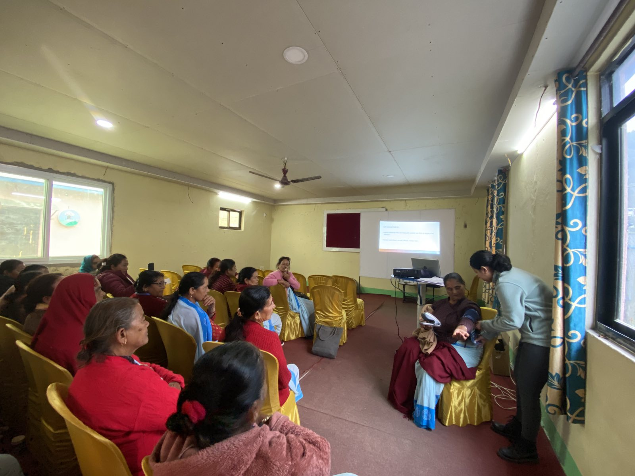
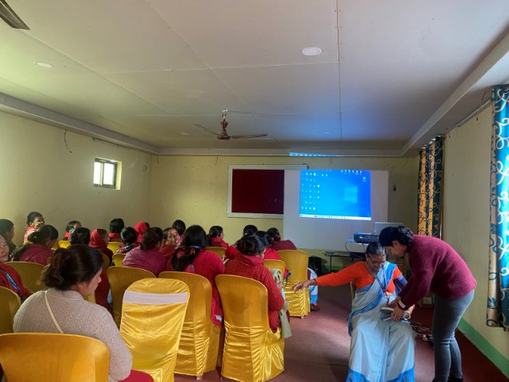
2) Blood pressure measurement skills
Provided clear instructions and training on measuring and recording blood pressure accurately through digital blood pressure machine.
Notes:
So the next training was on BP measurement skills, this was also a two our session….

Slide 15
Study variables
Dependent variables Independent variables
Hypertension knowledge score Socio-demographic characteristics
BP measurement skills score General performance measurement

Slide 16
Tools and technique
Variable | Tool | Technique | Validity/Reliability
Socio-demographic | Standard questions | Face - to- face interview | Standard tool in Nepal
Hypertension knowledge | Hypertension Knowledge Level Scale (HK-LS) | Face - to- face interview | Reliability and content validity of the original scale, developed in Turkey, were obtained as 0.82 and 60.3%. ¹⁶ Validated in Saudi Arabia, Indonesia and Brazil.¹⁸⁻²⁰ Pretested translated tool among 10% of the participants, Cronbach alpha (0.7).
Notes:
Since the tool was not validated in Nepal so we ………….

Slide 17
Tools and technique
Variable | Tool | Technique | Validity/Reliability
Skill level in BP measurement | BP measurement Score | Observational technique | Adopted from previous studies done in India¹⁷ Pretested translated tool among 10% of the participants , Cronbach alpha (0.8).
Notes:
Since the questions are not validated in Nepal so we……..

Slide 18
Tools and technique
Variable | Tool | Technique | Validity/Reliability
General performance | Standard Questions | Face to face interview | Adopted from the previous studies done in Kenya, India.^{21,22}

Slide 19
Data analysis: Descriptive
Quantitative data analysis conducted in STATA 14.
Frequencies (%) for categorical variables.
Mean (SD) and median(IQR) for continuous variables.

Slide 20
Data analysis: Analytical
Paired t-test was done for before and after Training Evaluation.
Exposure
Outcome
Socio demograhic
General performance
Hypertension Knowledge score
BPmeasurement Skills score
Association
Multiple linear regression

Slide 21
Ethical consideration
Research was approved by the Institutional Review Committee (IRC) of Kathmandu University School of Medical Sciences.
Consent form
Voluntary participation

Slide 22
Results: Quantitative
Table 1 Socio-demographic characteristics of the participants (n=131)
Characteristics | Frequency (%)
Age(Mean±SD) | 47.0±10.4
Educational level
Illiterate | 47 (35.8)
Primary level | 49 (37.4)
Secondary level | 25 (19.0)
Higher secondary level | 10 (7.6)
Ethnicity
Brahmin/chhetri | 73 (55.7)
Newar | 13 (9.9)
Rai/limbu/Sherpa | 32 (24.4)
Others | 13 (9.9)
Religion:
Hindu | 89 (67.9)
Non-Hindu | 42 (32.0)
Occupation
Homemaker | 10 (7.6)
Agriculture | 115 (87.7)
Others | 6 (4.5)

Slide 23
Table 1 Socio-demographic characteristics of the participants (n=131)
Characteristics | Frequency (%)
Monthly income in NRs median (IQR) | 5000 (10000-3000)
Annual household per capita income median (IQR) | 25000 (45000-10000)
Number of training received during past 12 months (Mean± SD) | 1.9±1.4
Duration worked as an FCHVs in years (Mean±SD) | 18.6±12.8
Received training on hypertension
Yes | 9 (6.8)
No | 122 (93.1)

Slide 24
Table 2 General Performance of the participants (n=131)
Characteristics | Frequency (%)
Report submitted in the last six months (Mean±SD) | 5.8±0.8
Total working hours per week median (IQR) | 20 (30-12)
Type of work as an FCHVs
Vitamin A distribution | 76 (58.0)
Health counselling | 69 (52.6)
Iron/Zinc tablet | 25 (19.0)
Distribution of anti-helmintic drugs | 23 (17.5)
Weighing children | 12 (9.1)
Others | 43 (32.8)
House visit per day during working days (Mean±SD) | 15.1±15.7
Notes:
Total working hours per week median is 20, 58% had distributed vitamin A

Slide 25
Table 3 Pre and post-training difference of knowledge and blood pressure measurement skills score (n=131)
Characteristics | Post-training |  | Pre-Training |  | Difference |  | 95% CI | P-value
Overall | Mean | SE | Mean | SE | Mean | SE
Knowledge score | 20.47 | 0.13 | 18.95 | 0.34 | 1.51 | 0.36 | 0.80, 2.23 | <0.0001
Skills score | 13.21 | 0.29 | 1.52 | 0.23 | 11.68 | 0.34 | 10.99, 12.37 | <0.0001
*In the paired t-test, the knowledge score ranges from 0-22; a higher score means better knowledge. The Skills score ranges from 0-17, indicating a higher skill level. Bold p-values indicate significance at a 5% level of significance
Notes:
After the training, the knowledge score was increased by an average of 1.51 and BP measurement skills increased by an average of 11.68.

Slide 26
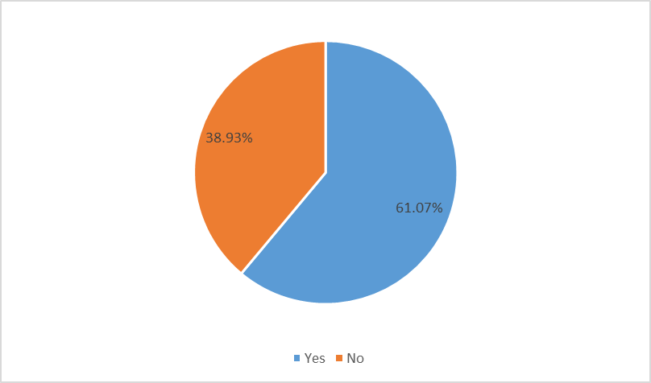
Figure 1 End-line Blood pressure measurement skills (n=131)
*Skills score ranges from 0-17, four statement was taken (Placement of measuring arm at level of heart, Proper fastening of the cuff, Measuring blood pressure 3 times at 1 (or more) minute(s) interval, Recording of all readings) and those who fulfill all 4 criteria was measured.
Notes:
Figure 1 describes the percentage of End-line Blood pressure measurement skills. After the training, about 61% were able to successfully measure and record blood pressure compared to the baseline which is 0%.

Slide 27
Table 4 Association of socio-demographic with end-line hypertension knowledge score (n=131)
 | Univariate |  |  |  | Multivariate
Variables | β Coefficient | 95% CI | P-value | β Coefficient | 95% CI | P-value
Age | 0.04 | 0.01, 0.07 | <0.001 | 0.01 | -0.03,0.05 | 0.67
Educational level
Illiterate | Ref |  |  | Ref
Primary level | -0.52 | -1.15, 0.09 | 0.09 | -0.23 | -0.93, 0.47 | 0.51
Secondary level | -0.83 | -1.59, -0.07 | 0.03 | -0.32 | -1.42, 0.76 | 0.55
Higher secondary level | -1.11 | -2.18,-0.04 | 0.04 | -0.40 | -1.78, 0.97 | 0.56
Ethnicity
Brahmin/chhetri | Ref |  |  | Ref
Newar | 0.33 | -0.56, 1.24 | 0.74 | 0.41 | 0.52, 1.36 | 0.38
Rai /limbu/Sherpa | -1.05 | -1.69, -0.41 | <0.001 | -0.80 | -1.49, -0.11 | 0.02
Others | -0.43 | -1.33, 0.47 | 0.33 | -0.34 | -1.27 ,0.59 | 0.47

Slide 28
Table 4 Association of socio-demographic with end-line hypertension knowledge score (n=131)
 | Univariate |  |  |  | Multivariate
Variables | β Coefficient | 95% CI | P-value | β Coefficient | 95% CI | P-value
Occupation
Homemaker | Ref |  |  | Ref
Agriculture | 0.38 | -0.64, 1.41 | 0.46 | 0.33 | -0.69, 1.35 | 0.52
Others | 0.73 | -.0.88, 2.35 | 0.37 | 0.76 | -0.82, 2.36 | 0.34
Annual household per capita income | 3.66 | -1.77, 9.10 | 0.18 | 2.87 | -2.46, 8.19 | 0.28
Duration worked as an FCHVs in years | 0.03 | 0.01, 0.05 | <0.001 | 0.01 | -0.01, 0.47 | 0.30
Received training on hypertension
Yes | -0.15 | -1.23,0.93 | 0.78 | -0.42 | -1.51, 0.65 | 0.43
No | Ref |  |  | Ref
*Bold p-values indicate significant at 5% level of significance Abbreviation: FCHVs: Female Community health volunteers

Slide 29
Table 5 Association of socio-demographic with end-line BP measurement skills score (n=131)
 | Univariate |  |  | Multivariate
Variables | β Coefficient | 95% CI | P-value | β Coefficient | 95% CI | P-value
Age | -0.06 | -0.12, -0.01 | 0.014 | -0.04 | -0.15, 0.06 | 0.39
Educational level:
Illiterate | Ref |  |  | Ref
Primary level | 1.02 | -0.32, 2.37 | 0.13 | 0.49 | -1.07, 1.06 | 0.53
Secondary level | 2.12 | 0.56,3.83 | 0.009 | 0.97 | -1.47, 3.41 | 0.43
Higher secondary level | 0.63 | -1.66, 2.93 | 0.58 | -0.72 | -3.81, 2.35 | 0.64
Ethnicity
Brahmin/chhetri | Ref |  |  | Ref
Newar | -0.21 | -2.25, 1.83 | 0.83 | -0.70 | -2.82, 1.40 | 0.50
Rai /limbu/Sherpa | 0.02 | -1.41, 1.46 | 0.97 | -0.53 | -2.07, 1.00 | 0.49
Others | -0.59 | -2.63, 1.44 | 0.56 | -0.46 | -2.54,1.61 | 0.65

Slide 30
Table 5 Association of socio-demographic with end-line BP measurement skills score (n=131)
 | Univariate |  |  | Multivariate
Variables | β Coefficient | 95% CI | P-value | β Coefficient | 95% CI | P-value
Occupation
Homemaker | Ref |  |  | Ref
Agriculture | -2.38 | -4.57, -0.19 | 0.03 | -2.07 | -4.35, 0.21 | 0.07
Others | -2.06 | -5.49, 1.36 | 0.23 | -2.29 | -5.84, 1.26 | 0.20
Annual household per capita income | -2.08 | 0.00001,9.69 | 0.72 | -4.97 | -0.00001, 0.00001 | 0.93
Duration worked as an FCHVs in years | -0.05 | -0.09, 0.009 | 0.017 | -0.02 | -0.09, 0.04 | 0.53
Received training on hypertension
Yes | 1.08 | -1.23, 3.40 | 0.35 | 1.51 | -0.91,3.94 | 0.21
No | Ref |  |  | Ref
*Bold p-values indicate significant at 5% level of significance Abbreviation: FCHVs: Female Community health volunteers​

Slide 31
Table 6 Association of FCHVs general performance with end-line hypertension knowledge score (n=131)
 | Univariate |  |  | Multivariate
Variables | β Coefficient | 95% CI | P-value | β Coefficient | 95% CI | P-value
Report submitted in the six months | 0.13 | -0.16, 0.4 | 0.37 | 0.09 | -0.20, 0.39 | 0.53
Total working hours per week | 0.003 | -0.05, 0.01 | 0.46 | 0.0003 | -0.009, 0.009 | 0.94
*Adjusted for age, education, ethnicity, occupation, Annual household per capita income.

Slide 32
Table 7 Association of FCHVs general performance with end-line BP measurement skills score (n=131)
 | Univariate |  |  | Multivariate
Variables | β Coefficient | 95% CI | P-value | β Coefficient | 95% CI | P-value
Report submitted in the last six months | -0.34 | -1.00, 0.31 | 0.30 | 0.09 | -0.20, 0.39 | 0.53
Total working hours per week | -0.001 | -0.02, 0.17 | 0.84 | 0.004 | -0.01 0.02 | 0.68
*Adjusted for age, education, ethnicity, occupation, Annual household per capita income.​

Slide 33
Conclusion
One day training intervention is effective for improving knowledge and blood pressure measurement skills.
FCHV characteristics and their earlier performance did not affect the change in knowledge and BP measurement skills after training.
Notes:
Overall findings indicates that.

Slide 34
Recommendation
Namobudhha and Mandandeupur are semi-urban municipalities in Nepal. Effectiveness is to be further tested in rural areas of Nepal.
Future studies may use randomized controlled trials to control for measured and unmeasured confounding.
More trainings related to hypertension management and automatic blood pressure machine should be provided to FCHVs.

Slide 35
References
Lopez AD, Mathers CD, Ezzati M, Jamison DT, Murray CJL. Global and regional burden of disease and risk factors, 2001: systematic analysis of population health data. Lancet Lond Engl. 2006 May 27;367(9524):1747–57.
Mills KT, Stefanescu A, He J. The global epidemiology of hypertension. Nat Rev Nephrol. 2020 Apr;16(4):223–37.
Dhimal M, Bista B, Bhattarai S, Dixit LP, Hyder MKA, Agrawal N, et al. Report of Non-Commnunicable Disease Risk factor: STEPS Survey. Kathmandu, Nepal: Nepal Health Research Council; 2019.
Khatri RB, Mishra SR, Khanal V. Female Community Health Volunteers in community-based Health programs of Nepal: futureh Perspective. Front Public Health. 2017 Jul 21;5:181.
Government of Nepal-Ministry of Health and Population, Department of Health Services. Annual Health Report [Internet]. Nepal; 2079.
Neupane D, McLachlan CS, Mishra SR, Kallestrup P. Understanding and Motivations of Female Community Health Volunteers About Blood Pressure Control: A Prerequisite for Developing Community-Based Hypertension Interventions in Nepal. Glob Heart. 2017 Sep 1;12(3):227–32.
Sengwana MJ, Puoane T. Knowledge, beliefs and attitudes of community health workers about hypertension in the Cape Peninsula, South Africa. Curationis. 2004 Sep 28;27(1):65–71.

Slide 36
References
8. Abdel-All Marwa, Putica Barbara, Praveen Deversetty, Abimbola Seye, Joshi Rohina. Effectiveness of community health worker training programmes for cardiovascular disease management in low-income and middle-income countries: a systematic review | BMJ Open. 2017.
9. Kawakatsu Y, Sugishita T, Tsutsui J, Oruenjo K, Wakhule S, Kibosia K, et al. Individual and contextual factors associated with community health workers’ performance in Nyanza Province, Kenya: a multilevel analysis. BMC Health Serv Res. 2015 Oct 1;15(1):442.
10. Neupane D, McLachlan CS, Mishra SR, Kallestrup P. Understanding and Motivations of Female Community Health Volunteers About Blood Pressure Control: A Prerequisite for Developing Community-Based Hypertension Interventions in Nepal. Glob Heart. 2017 Sep 1;12(3):227–32.
11. Neupane dinesh, McLachlan CS, Mishra SR, Olsen MH, Perry HB, Karki A. Effectiveness of a lifestyle intervention led by female community health volunteers versus usual care in blood pressure reduction (COBIN): an open-label, cluster-randomised trial | Elsevier Enhanced Reader. 2018.
12. Timalsina P, Singh R. Assessment of Risk Factors of Noncommunicable Diseases among Semiurban Population of Kavre District, Nepal. J Environ Public Health. 2021 Jun 8;2021:e5584561.
13. Sangprasert P. The Effects of a Training Program for the Development of Hypertension Knowledge and Basic Skills Practice (HKBSP) for Thai Community Healthcare Volunteers. Siriraj Med J. 2011;63(5):163–7.
14. Singh ND and M. Sample Size Calculator for Comparing Paired Differences [Internet]. [cited 2023 Jul 13].

Slide 37
References
15. Urich A. The Health Belief Model. 2017 [cited 2024 Feb 24]
16. Erkoc SB, Isikli B, Metintas S, Kalyoncu C. Hypertension Knowledge-Level Scale (HK-LS): A Study on Development, Validity and Reliability. Int J Environ Res Public Health. 2012 Mar;9(3):1018–29.
17. Mondal S, Mondal H, Dutta R, Pal A, Acharya SS, Baidya C. Competency in Home Blood Pressure Monitoring and Effect of Training Program on Competency. J Clin Diagn Res. 2018 Apr 1;12.
18. Alshammari SA, Alshathri AH, Aldharman SS, Alshathri AH, Abukhlaled JK, Alabdullah DW, et al. Construct Validity and Reliability of the Arabic Version of Hypertension Knowledge-Level Scale Among Saudi Population. Cureus. 14(12):e33182.
19. Arthur perez Juliana, Mantoni Fatima de maria, Ferraz Raimondo Isabel Maria, Mattei Tais Angela, Kalinke Puchalski Luciana, Corpolato de Roselene. SciELO - Brazil - Translation and cross-cultural adaptation of the Hypertension Knowledge-Level Scale for use in Brazil Translation and cross-cultural adaptation of the Hypertension Knowledge-Level Scale for use in Brazil. 2018.
20. Ernawati I, Fandinata SS, Permatasari SN. Translation and Validation of the Indonesian Version of the Hypertension Knowledge-level Scale. Open Access Maced J Med Sci. 2020 Oct 16;8(E):630–7.
21. South-East Asia | Where We Work | World Heart Federation [Internet]. [cited 2024 Feb 4].
22. Dhital SM. Dealing with the burden of hypertension in Nepal: current status, challenges and health system issues. In 2013 [cited 2023 Feb 5].

Slide 38


Slide 39
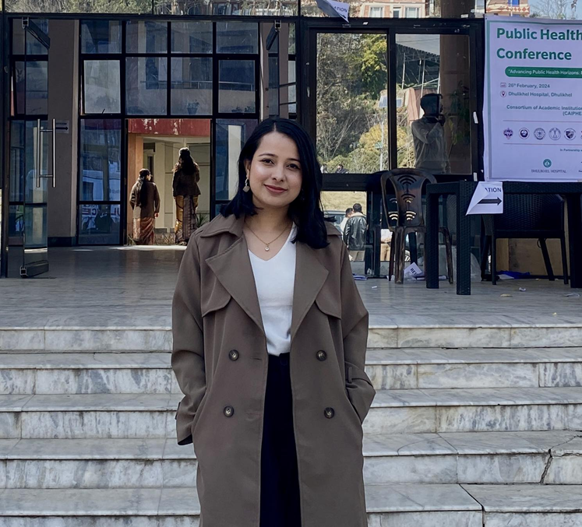
Prasansha Poudel
Student at Kathmandu university School of Medical Sciences pursuing Masters of Science in Public Health with major in Global Health.

